Slide 1
Aggregations in Power BI
Guru prasad Vijayarao
4/1/2020
Notes:
https://docs.microsoft.com/en-us/power-bi/desktop-aggregations

Slide 2
Create an aggregated table
Direct Query with large model
Boost performance with Aggregate tables
Generate a summary table the engine can use and avoid complete table scan.
DAX Studio to trace Power BI Queries

Slide 3
Aggregation and Relations
Based on Group By columns.
Aggregation by Specific Value
Based on Relationships.
Aggregation by Dimention Key
Note
DISTINCT COUNT DAX can take advantage of Group By
Average can take advantage of SUM, COUNT
Count table rows helps

Slide 4
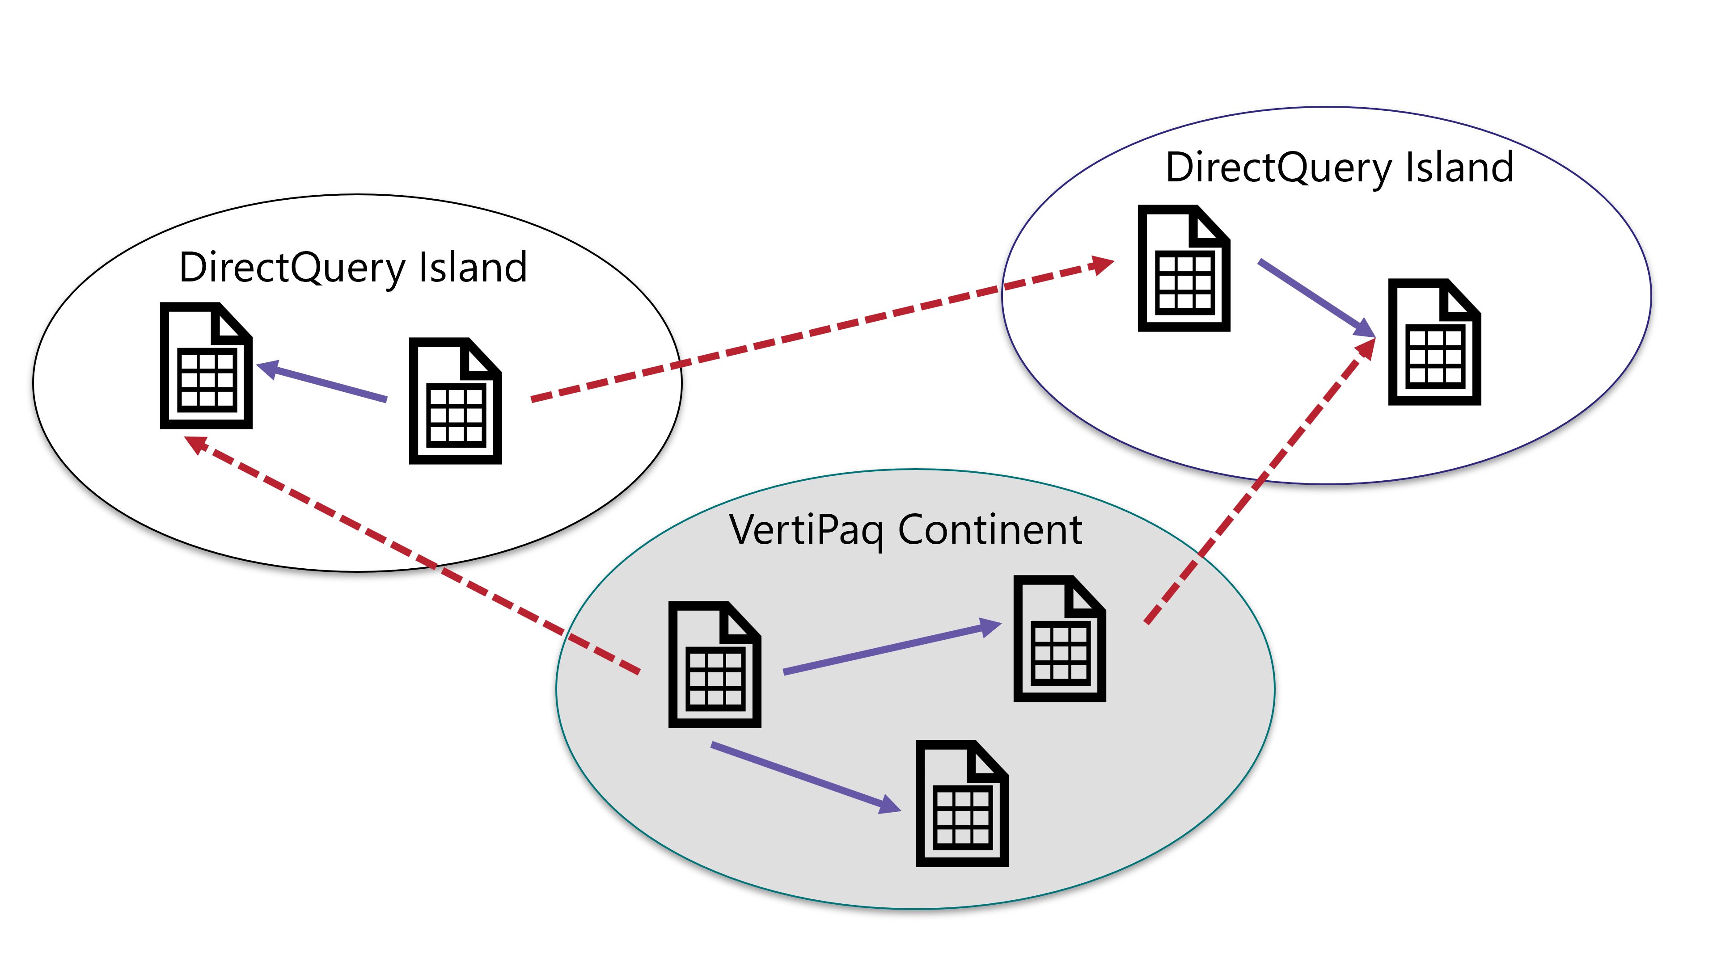
Storage Mode
Relationship rules for aggregation hits
Many Side Ex Sales | One Side Ex Date
Dual | Dual
Import | Dual / Import
DQ | Dual / DQ
Storage Mode
Direct
Import
Dual
Relations
Strong
Week
(both side are from a single source)
Image fom SQL BI

Slide 5
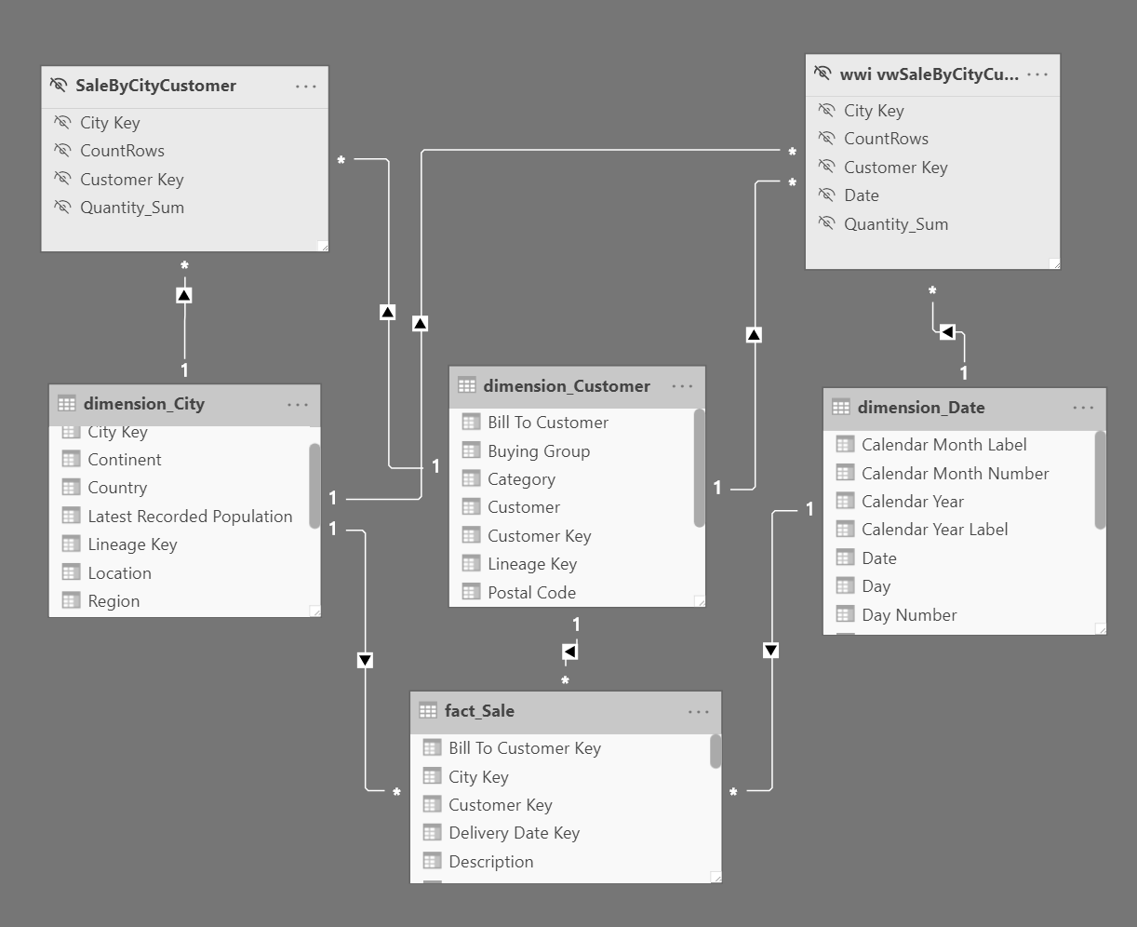
Import
DQ
Dual
Dual
DQ
DQ

Slide 6
Precedence
Multiple Aggregation Tables
Direct Query Mode Aggregate Table
In-memory Mode Aggregate Table
Higher precedence table considered first.

Slide 7
Aggregation Tables
Direct Query Table
Externally managed
Physical Table + Column store
External Table
Indexed View Table
Views
In memory Table
Import Mode
Power Query Generated Table
Incremental Refresh

Slide 8
Limitations
Plan to manage the sync between Aggregated and Detailed tables
Data Type Must be same
3 Levels - Chained aggregations
Duplicate aggregations – Not allowed
Detail Table must be Direct Query
USERELATIONSHIP Not supported

Slide 9
Creative Aggs
Check out Phil Seamark’s blog
Horizontal Aggs - Mixing Agg and base table
Accordion Aggs - Variable grain aggs
Filtered Aggs - Recent data & older data
Incremental Aggs
Shadow Models - Duplicate table (DQ & Import)
Richard Tkachuk’s blog
HyperLogLog Aproximate Distinct Count

Slide 10
Additional Resources
Aggregations in Power BI – Doc
Sample Data
New York Taxicab Data – Doc
Adventureworks – Doc
Wide World Importers – Doc
Related Talks
Christian Wade Demo
Alberto Demo
Strong, Week Relation
Fast and Furious with Aggregations

Slide 11
Thank You!
For Questions / Feedback
reach me at
guvijaya@Microsoft.com

